Slide 1
COP3503
Type Safe Languages

Slide 2
Types
Primitive
Defined by the language
int, float, bool, char
Composite
More than one primitive type
Array
Abstract
Implementation not defined
Stack, queue, set, map
Other
Pointers

Slide 3
Type Safety – Ensure Correct Interpretation of Data
32 bits can be interpreted as
an instruction
a floating point number
an integer
four characters

Slide 4
Correct Interpretation of Data
Memory addresses point to a byte of memory
Memory Address Data at that Address
0x0000 007F F31E 0878 1110 0011

Slide 5
Correct Interpretation of Data
Memory addresses point to a byte of memory
Memory Address Data at that Address
0x0000 007F F31E 0878 1110 0011
0x0000 007F F31E 0879 0000 0000
&myVar = 0x0000 007F F31E 0878;
myVar = ? Depends on type

Slide 6
Correct Interpretation of Data
Memory addresses point to a byte of memory
Memory Address Data at that Address
0x0000 007F F31E 0878 1110 0011
0x0000 007F F31E 0879 0000 0000
char * myVar
&myVar = 0x0000 007F F31E 0878
→ myVar = “π”

Slide 7
Correct Interpretation of Data
Memory addresses point to a byte of memory
Memory Address Data at that Address
0x0000 007F F31E 0878 1110 0011
0x0000 007F F31E 0879 0110 0001
0x0000 007F F31E 0880 0000 0000
char * myVar = new char[3]
&myVar = 0x0000 007F F31E 0878
→ myVar = “πΑ”

Slide 8
Correct Interpretation of Data
Memory addresses point to a byte of memory
Memory Address Data at that Address
0x0000 007F F31E 0878 1110 0011
0x0000 007F F31E 0879 0110 0001
unsigned short myVar;
&myVar = 0x0000 007F F31E 0878
→ myVar = 58,209

Slide 9
Correct Interpretation of Data
Memory addresses point to a byte of memory
Memory Address Data at that Address
0x0000 007F F31E 0878 1110 0011
0x0000 007F F31E 0879 0000 1101
short myVar
&myVar = 0x0000 007F F31E 0878
→ myVar = −7327

Slide 10
Correct Interpretation of Data
type checking
verifying the constraints of types
int x;
x = “3”;
error: assigning to 'int' from incompatible type 'const char [2]'

Slide 11
Correct Interpretation of Data
type error
A type error is program behavior in which an operation occurs on a particular data type that it’s not meant to occur on
type-safe
Operations are always compatible with the data type
Type errors are kept to a minimum.
There is a course of action when type errors occur
(e.g. throw an exception…)
Any attempt to misinterpret data is caught at compile time or generates a well-specified error at run time
That’s squishy ….
Type-safe is not binary

Slide 12
Correct Interpretation of Data
static type checking
the type of a variable is known at compile time
compiled code executed quickly
dynamic type checking
types are checked at run time
may cause run-time errors that can be difficult to fix

Slide 13
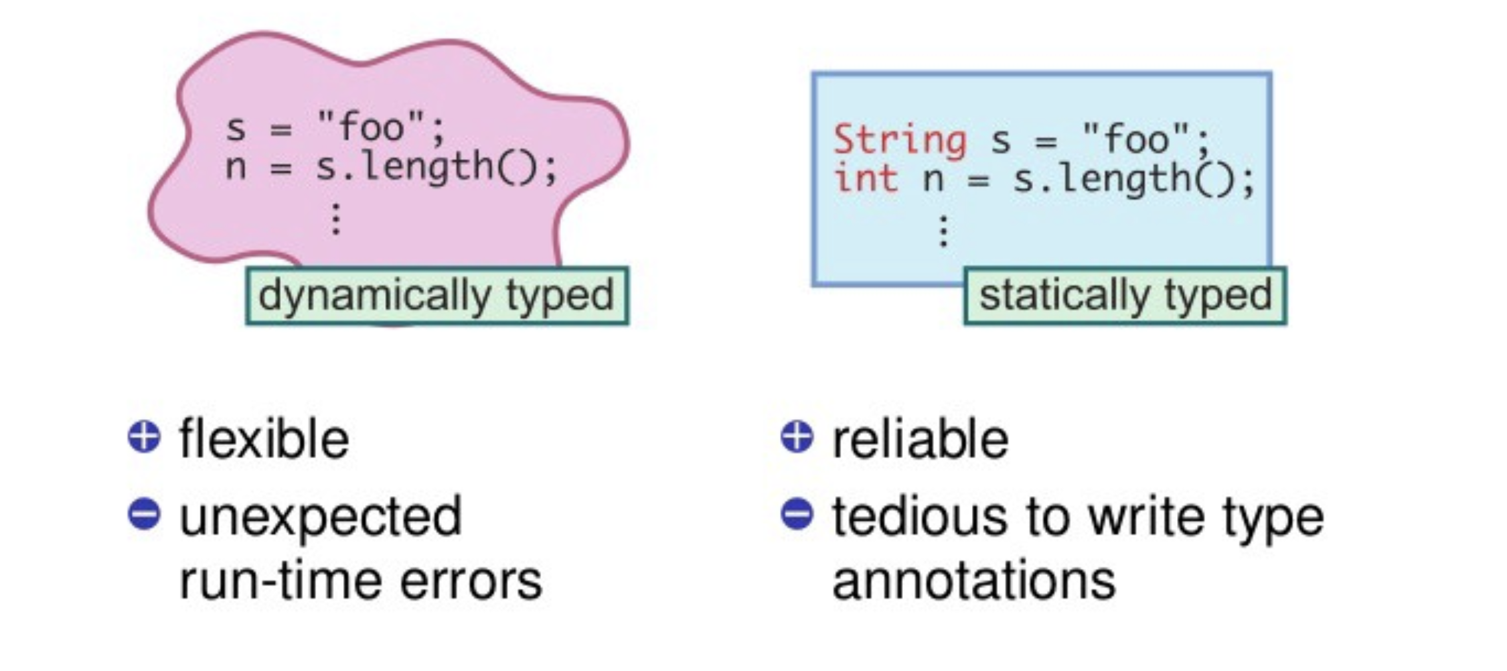
Static vs. Dynamic Typing

Slide 14
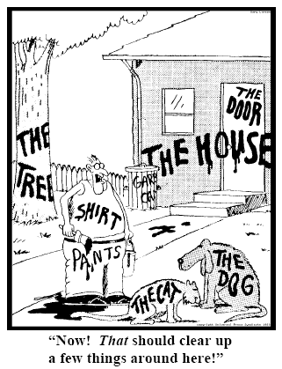
Static vs. Dynamic Typing

Slide 15
Static vs Dynamic Typing
Suppose some error occurs at runtime that is related to a variable’s value being used in an inappropriate way —like dividing a string value by 2.
An error message appears
The programmer has to find the source of the error,
which may be far from the point of detection of the error and this can take a great deal of time.
But if type-checking was done at compile-time, the point of detection of the error might have been obvious without even running the program.

Slide 16
Correct Interpretation of Data
Type-safety is enforced by strong typing
strongly typed
variables are bound to specific data types, and will result in type errors if types to not match up as expected in the expression – regardless of when type checking occurs
syntactically, it is impossible to have an operation disregard the types of its operands, to interpret a value as something that it is not
weakly typed
variables are not bound to a specific data type; they still have a type, but type safety constraints are lower compared to strongly-typed languages

Slide 17
Correct Interpretation of Data
https://medium.com/android-news/magic-lies-here-statically-typed-vs-dynamically-typed-languages-d151c7f95e2b

Slide 18
C does not enforce type-safety
Type-safety – the ability of the programmer to get around the limitations of type.

Slide 19
C does not enforce type-safety
Type-safety – the ability of the programmer to get around the limitations of type.
The language C does not enforce type safety.

Slide 20
C does not enforce type-safety
Type-safety – the ability of the programmer to get around the limitations of type.
The language C does not enforce type safety.
It was initially developed in order to have a language in which to write the operating system UNIX
created as a research tool at Bell Labs
write assembly language with fewer instructions

Slide 21
C does not enforce type-safety
Type-safety – the ability of the programmer to get around the limitations of type.
The language C does not enforce type safety.
It was initially developed in order to have a language in which to write the operating system UNIX
created as a research tool at Bell Labs
write assembly language with fewer instructions
As such, it had to allow the ability to look at and change specific memory locations
C offers explicit control over the layout of objects in memory

Slide 22
C does not enforce type-safety
There is also built-in protection against using pointer manipulation to access almost any part of memory
“Pointer arithmetic” is not allowed in Java

Slide 23
C and type-safety
Arrays are not bounds checked
double array[3] = {1, 2, 3};
array[10] = 3;

Slide 24
C and type-safety
Arrays are not bounds checked
double array[3] = {1, 2, 3};
array[10] = 3;
Will overwrite whatever was there

Slide 25
C and type-safety
Arrays are not bounds checked
double array[3] = {1, 2, 3};
int x = array[10];
Will interpret whatever is there as an int

Slide 26
C and type-safety
Why is this risky?
Casts provide a trivial way to store arbitrary instructions into code addresses. A standard C-code "exploit" (malicious attack) involves writing some "bad" instructions into some location in memory that will later be executed.
These instructions might, for example, store the entry location of virus-code.
/* pretend 0x010000 is a hexadecimal address of code */ int i = 0x010000; /* treat this integer as a pointer, using a cast */ int * i_ptr = (int*)i; /* store through this pointer --- placing bad data at address */ (*i_ptr) = 0xBADCAT;
Later, when the code jumps to 0x010000, the code will execute the instruction 0xBADCAT instead of whatever instruction was there before.
http://courses.cs.washington.edu/courses/cse341/04wi/lectures/26-unsafe-languages.html

Slide 27
C is not type-safe
Let’s unpack this a bit
int jjj=3; long int iii = (long int)&jjj;
A contrived way to give variable iii a value that is an address.

Slide 28
C is not type-safe
Let’s unpack this a bit
int jjj=3; long int iii = (long int)&jjj;
/* treat this integer as a pointer, using a cast */ int* i_ptr = (int*)iii;
Cast the value to a pointer

Slide 29
C is not type-safe
Let’s unpack this a bit
int jjj=3;
long int iii = (long int)&jjj;
/* treat this integer as a pointer, using a cast */ int* i_ptr = (int*)iii;
*i_ptr+=4;
Cast the value to a pointer
The data at the address that iii contains is now changed

Slide 30
C is not type-safe
Let’s unpack this a bit
int jjj=3;
long int iii = (long int)&jjj;
/* treat this integer as a pointer, using a cast */ int* i_ptr = (int*)iii;
*i_ptr+=4;
Cast the value to a pointer
The data at the address that iii contains is now changed
It’s a contrived example (extremely contrived….)
But because of the cast, the value of the data at the address of iii is changed
If iii is an address of an instruction to execute, the instruction has been changed

Slide 31
C is not type-safe
Let’s unpack this a bit
int jjj=3;
long int iii = (long int)&jjj;
/* treat this integer as a pointer, using a cast */ int* i_ptr = (int*)iii;
*i_ptr+=4;
Cast the value to a pointer
The data at the address that iii contains is now changed
It’s a contrived example (extremely contrived….)
But because of the cast, the value of the data at the address of iii is changed
If iii is an address of an instruction to execute, the instruction has been changed
People who write malware have more time to use this in more insidious (not contrived) ways…..

Slide 32
Why Not Type Safe?
C/C++ often chosen for performance reasons
Manual memory management
Interaction with low-level hardware
Enforcement of type safety is expensive
Garbage collection
Bounds and null-pointer checks
Casts, pointer arithmetic and & operator not allowed
CS definition of expensive = time consuming

Slide 33
Summary
Type checking
Verifying the constraints of type
Static type checking - done at compile time
Dynamic type checking – done at run time
Type safety
Enforcement of type – strongly typed = strong enforcement
Ensuring operations are compatible with data type
C/C++
Pointers, casts, and manual memory management make C/C++ not type-safe

Slide 34
You have reached the end of this presentation.

